Slide 1
RAJASTHAN POLICE FEEDBACK SYSTEM

Slide 2
Introduction:
This website contains seven menu bar.
HOME
ABOUT
REGISTRATION
LOGIN
STATION LOGIN
ADMIN LOGIN
CONTACT

Slide 3
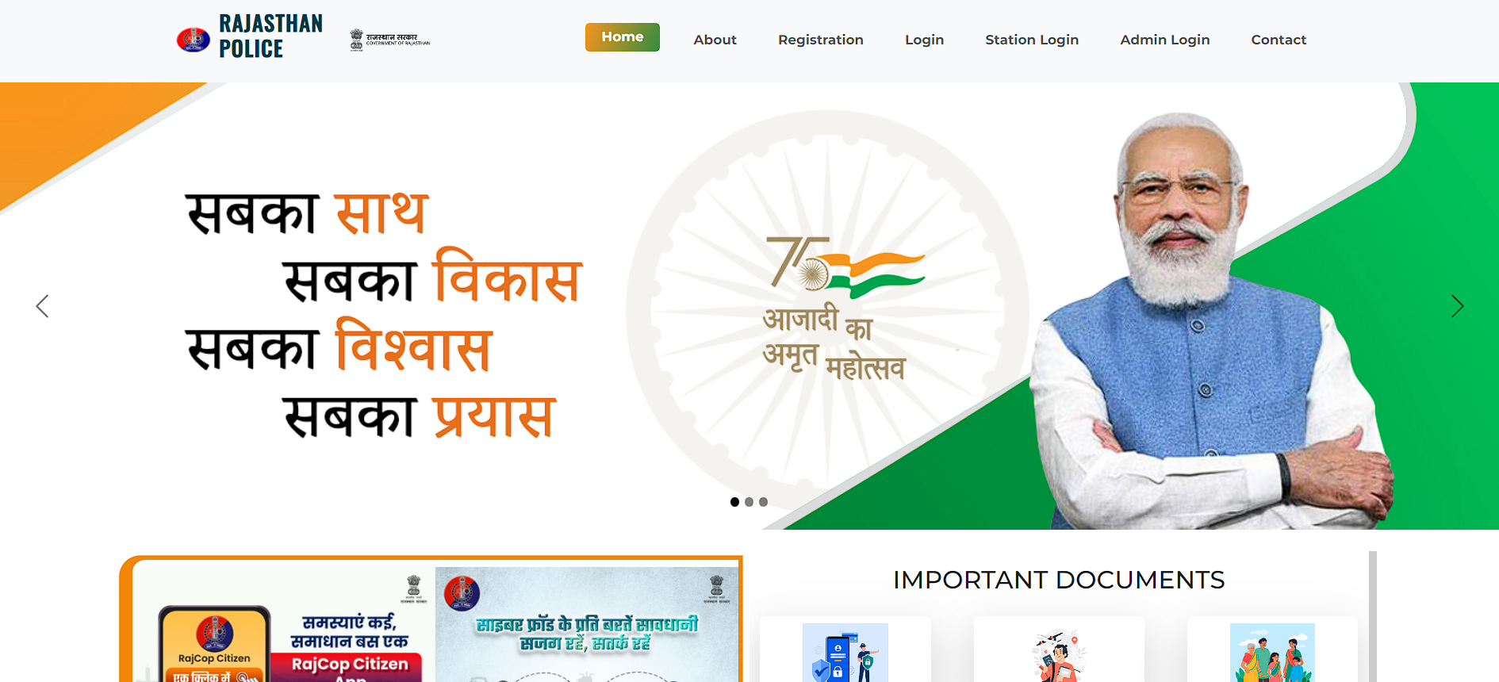
Home Page:
Home page includes :
Some important details and information about new rules and laws related to our Indian Constitution.
Brief introduction to Process of filing a FIR.
Rajasthan Police Social Media Handles.

Slide 4
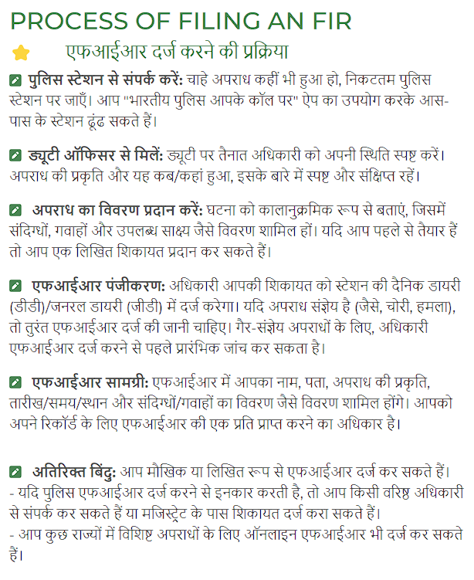
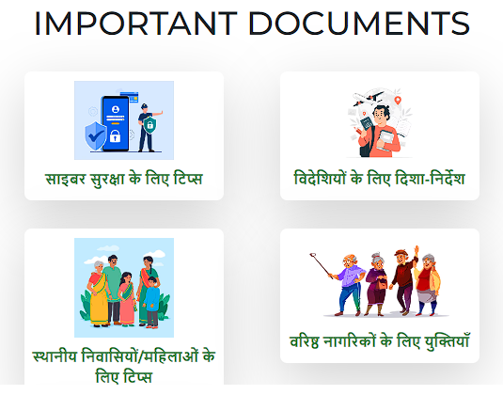

Slide 5
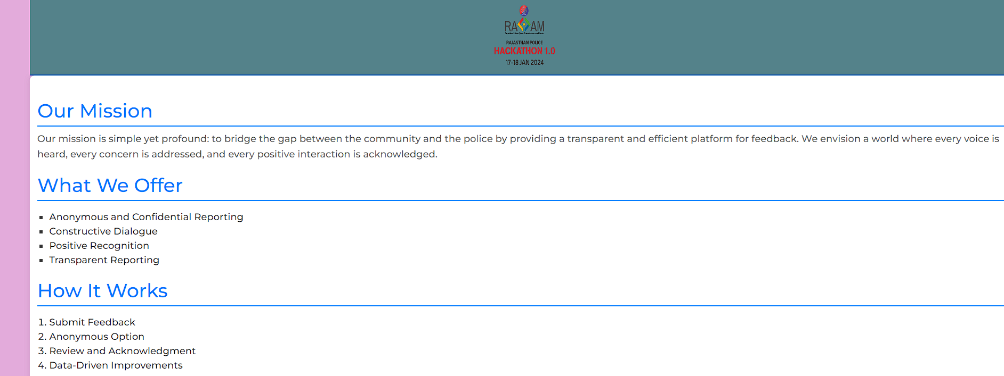

ABOUT PAGE :

Slide 6
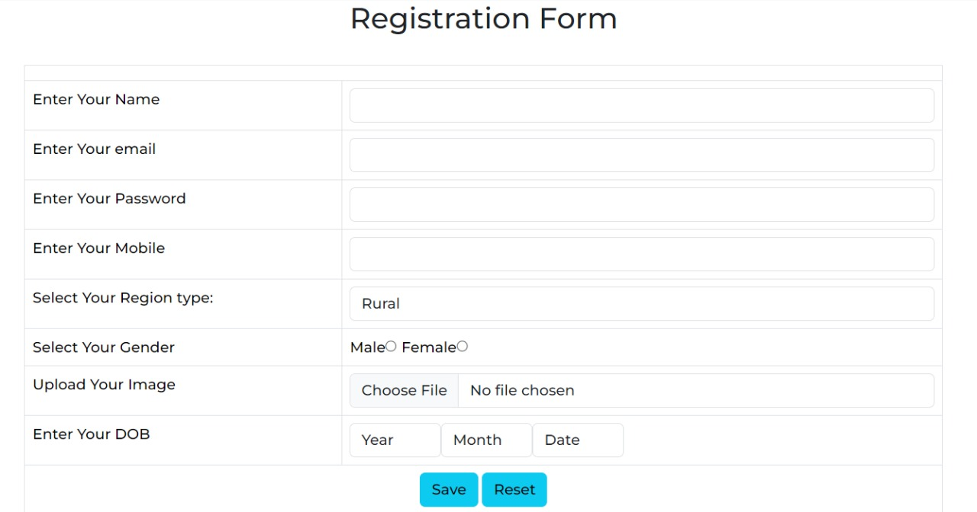
REGISTRATION PAGE :
User can easily register himself/herself by filing personal information like name, email, password, M.No. etc.

Slide 7
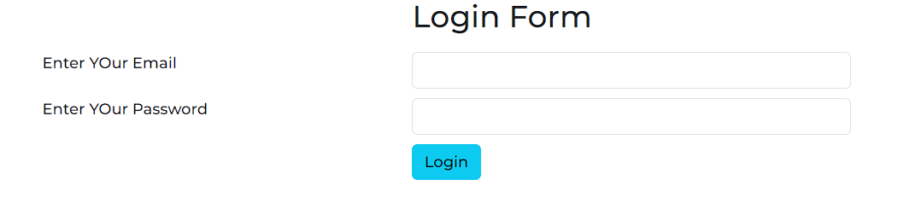
LOGIN PAGE :
In this, Registered user can login using Email and Password.
Eg. Email- raj785@hotmail.com
Pass- raj1234

Slide 8
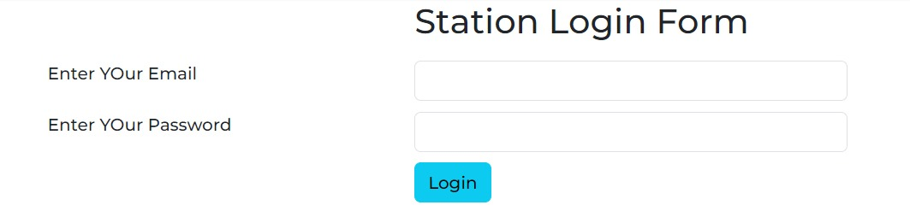
STATION LOGIN PAGE :
As like user, there is another option for Station Login. Every Police Station have it’s unique login ID, From that they can login easily.
Eg. Email- sanganer.polices@gmail.com
Pass- THAna1452@police

Slide 9
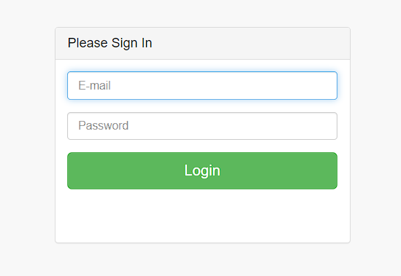
ADMIN PAGE :
Same like User and Station login this website does also contain Admin Login Page.
Eg. Email- admin.police@gmail.com
Pass- raj.police4596@system

Slide 10
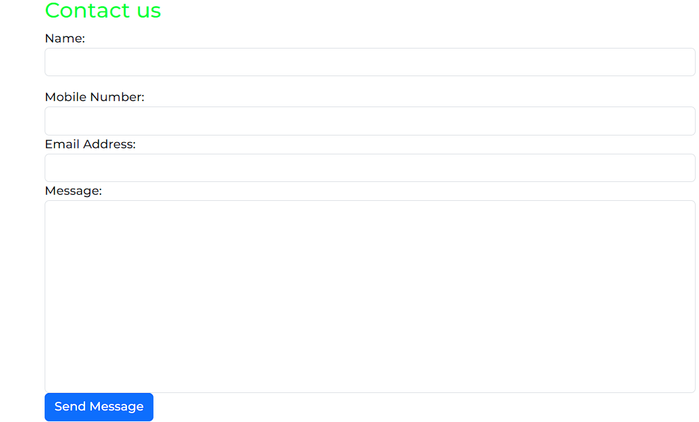
CONTACT:
User can directly contact with the Admin and also can drop a text based message.

